Slide 1
Closing

Slide 2

Company Expectations
If knocked down, I will get back up, every time
I will draw on every remaining ounce of experience to protect my teammates and to accomplish our business goals
I am never out of the fight
Discipline and Innovation is expected
Notes:
Warrior Creed

Slide 3
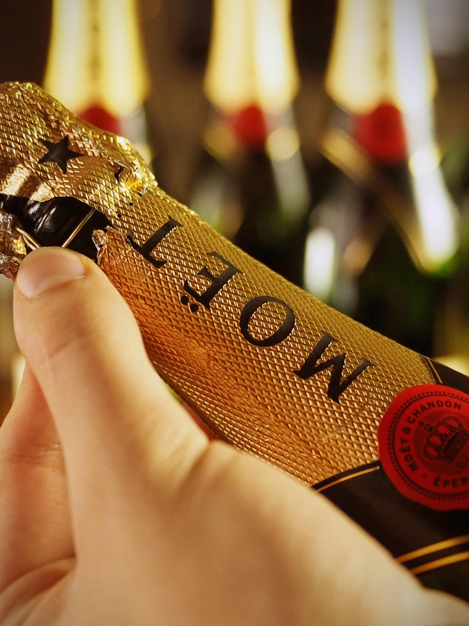
Celebrate with Team
Celebrate project completions and success with team member or entire team.
Celebrate your own successes.
Watch your team member and take every opportunity to pat them on the back for successes in and out of the office.

Slide 4

Leadership
The learning is never complete

Slide 5
End Closing

